Slide 1
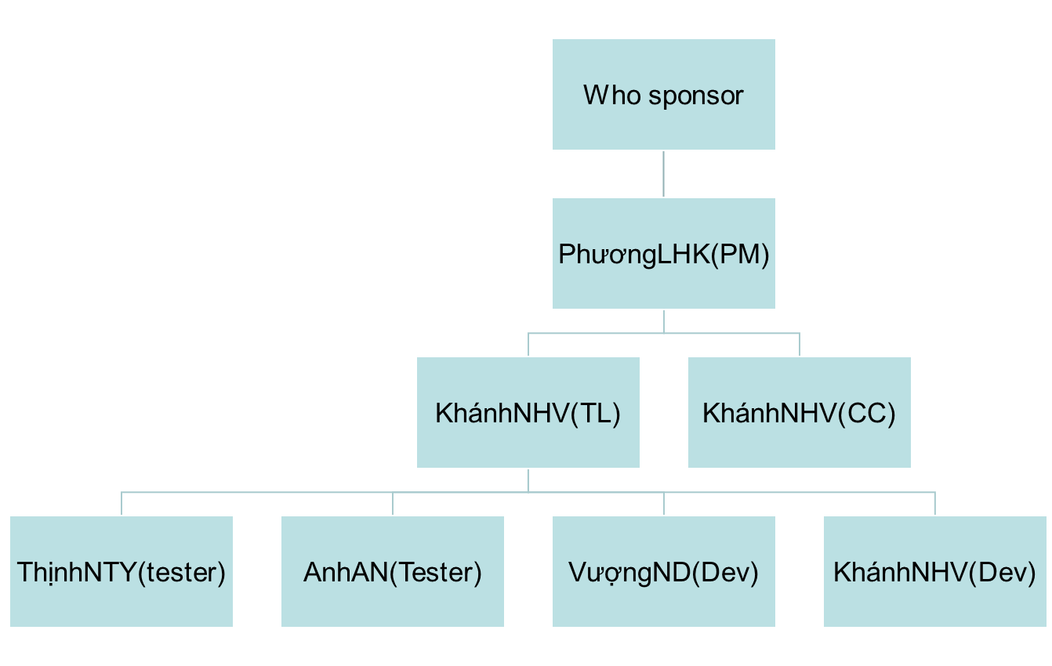
Project Name Organizational Chart
5/12/2012

